Slide 1
Value Sensitive Algorithm Design
HCIC 2018
Haiyi Zhu, Bowen Yu, Loren Terveen
GroupLens Center
University of Minnesota, Twin Cities
2018.06.25
Notes:
I am an assistant professor in the computer science department at the University of Minnesota, Twin Cities.
Today I am going to talk about “”:
This work is conducted with Bowen Yu, my PhD student, and Prof. Loren Terveen
All of us come from GroupLens, University of Minnesota, Twin Cities

Slide 2
AI and Social Decision Making
Artificially intelligent systems make important social decisions or assist humans to make such decisions.
Evaluate the risk level of offenders (Dressel and Farid 2018, Corbett-Davies et al. 2017).
Predict the risk of severe child maltreatment (Chouldechova et al., 2018).
Filter and rank the job applicants (WSJ 2012).
Notes:
Just to name a few examples
Intelligent algorithms have been increasingly used in the criminal justice system. Studies show that such algorithms have evaluated more than 1 million offenders.
Algorithms have been used in the public sector decision making. For example, Allegheny County in Pennsylvania has been using predictive risk algorithm to screen the referral calls on child maltreatment
It is estimated that over 90% of large companies use intelligent application tracking systems to automatically filter and rank the job applicants.

Slide 3
AI “rules the world”
Notes:
AI is going to rule the world
A lot of decisions that have traditionally been made solely by humans are now or will in future be made by algorithms (

Slide 4
AI Development
AI/Machine Learning is one of the fastest growing disciplines in the recent years.
Notes:
Numerous sophisticated algorithms have been created.

Slide 5
However
Technically solid algorithms can fail in multiple ways.
Notes:
There is an emerging body of studies show that

Slide 6
Aversion of AI Algorithms

Slide 7
Aversion of AI Algorithms
Even when algorithm predictions are proved to be more accurate than human predictions, experts and laypeople remain resistant to using algorithms
(Diab et al., 2011; Eastwood et al. 2012, Dietvorst et al. 2014, 2016, Lee and Baykal 2017).
Notes:
A series of research studies show that

Slide 8
Unintended Biases of AI Algorithms
https://www.nytimes.com/2015/07/10/upshot/when-algorithms-discriminate.html
Notes:
When people are worried that AI might take over our world,

Slide 9
Unintended Biases of AI Algorithms
African-American defendants are substantially more likely than White-American defendants to be incorrectly classified as high risk by the algorithms (e.g., Angwin et al. 2016).
Google Ads displayed more high paying jobs for male users than for female users (Datta et al. 2015).
Notes:
For example

Slide 10
Unintended Biases of AI Algorithms
In Wikipedia, among good-intentioned editors, newcomers’ edits are more likely to be classified as low quality compared to experienced editors (Halfaker et al. 2011).
Notes:
Biased algorithms are also affecting digital world.
Wikipedia has long been using algorithmic tools to automatically assess the quality of the edits and make corresponding actions.

Slide 11
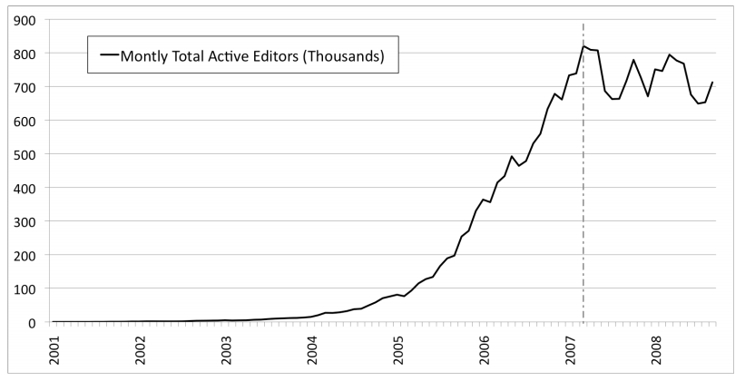
Biases Cause Negative Impacts
The algorithmic tools used to reject contributions are implicated as one of the key causes of decreased newcomer retention (Halfaker et al. 2011)
Notes:
You may have been already seen this famous figure about monthly total active editors in Wikpedia before.
There was a sudden decline of growth around 2007 in the monthly total active editors.
Are responsible for this decline.

Slide 12
Properties of Intelligent Systems
Evaluate certain aspect of a subject, often a person.
Evaluation outcomes are unobservable or difficult-to-observe (no clear ground-truth).
Social problem, with multiple stakeholders involved.
Notes:
That are often subject to such risks
Relating to the examples mentioned, the outcome might be the risk level of offenders, severe maltreatment of children or suitability of applicants to jobs and oraganizations.
Such problem are often social problem, with multiple stakeholders involved and are affecting a large group of people. Solutions at the individual level do not solve the problem.

Slide 13
Question
How can we improve algorithm acceptance, avoid bias, and prevent negative impacts?
Algorithm auditing (e.g., Sandvig et al. 2014)
Fairness-aware machine learning (e.g., Kamishima et al. 2011).
Instead, we look into the algorithm creation process.
Notes:
Instead of detecting bias and fixing bias in existing algorithms

Slide 14
Traditional Approach
Provide data (Passively)
Algorithm Creation, Iteration and Evaluation
Identify algorithmic approaches
Inputs of Algorithm
Historical data
Define features, criteria and constraints.
Hyperparameter tuning.
Evaluate model’s accuracy
Algorithm outcome
Predictive score or ranking
Identify prediction target
Stakeholders
Users of algorithmic tools
People who are affected by the algorithms
Algorithm Developers
Receive outcome
Affected by outcome
Stakeholders

Slide 15
Problems of such process
Algorithm creation is an opaque process to stakeholders.
Rely only on passive stakeholder-input (historical data), and fail to capture and incorporate explicit human insights.
The iteration and evaluation processes often only optimize models’ performance on one single target – accuracy, which is not sufficient to understand how the algorithms would work in the real world.
Notes:
/ōˈpāk/
Using history to inform the future runs the risk of reinforcing and repeating historical mistakes, stereotypes, and discrimination
Low acceptance of the algorithm, bias in the algorithm results, and potential negative impact

Slide 16
Our Approach: Value Sensitive Algorithm Design
Inspired by human-centered system design, participatory design and value-sensitive design.
Consider human values throughout the process of algorithm design in a principled and comprehensive manner.
Value: what a person or group of people consider important in life.
Participatory process that incorporates stakeholders’ tacit knowledge and insights into early stages of algorithm design.
Evaluate not just the model’s accuracy (which still is important), but also acceptability, and the impact of the algorithms
Notes:
Improve acceptance of the algorithmic tools, and avoid biases in the design choices and compromises of important stakeholder values.

Slide 17
Our Approach: Value Sensitive Algorithm Design
Provide data (Often passively)
Algorithm Creation, Iteration and Evaluation
Identify algorithmic approaches
Inputs of Algorithm
Historical data
Define features, criteria and constraints.
Hyperparameter tuning.
Evaluate model’s accuracy
Algorithm outcome
Predictive score or ranking
Identify prediction target
Stakeholders
Use multiple relevant stakeholders’ insights to guide the specific algorithmic choices
Stakeholders
Consider the social and organizational context
Algorithm Developers
Iterative and open refinement with stakeholders
Evaluate algorithm acceptance, accuracy and impacts
Receive outcome
Affected by outcome
Stakeholders
Notes:
In addition to mining the historical data, we also collect people’s explicit insights on how to use the historical dataset.
Consider the social and organizational context in the algorithm design…
For instance, how can we design algorithms that augment and improve the existing procedure and process
How to design the algorithm to better facilitate human. Such as how to make the most of human judgment and machine capability while avoiding human limitation and machine bias.

Slide 18
VSAD: 5-Step Approach
Step 1: Understand Stakeholders
Step 2. Algorithm Prototyping
Step 4: Iterative Refinement
Step 5: Acceptance, Accuracy and Impact (AAI) Evaluation
Step 3. Pilot Deploy Algorithm with Stakeholders
Notes:
Problem/challenge

Slide 19
Note
“Progress” not “Perfect” (Friedman et al.2017)
Notes:
Not possible to prevent all the possible biases
Consistent with Friedman et al.(2017), the value sensitive algorithm design approach does not aim at perfection, but rather tries to achieve progress on improving human well beings through
Consider human values throughout the process
Use stakeholders’ explicit insights on how to use the historical data
Incorporate stakeholders’ feedback to iterate on the design
Evaluating algorithms not only based on accuracy but also stakeholder acceptance and impacts of the algorithm on them
We still use the historical dataset. But collect people’s explicit insights on how to use the historical dataset.

Slide 20
Outline
Part 1. Overview of the VSAD approach
Part 2. Designing value-sensitive recruitment algorithms for projects in Wikipedia
Context and challenges
5-step process of creation and evaluation
Part 3. Lessons, Challenges and Discussions

Slide 21
Outline
Part 1. Overview of the VSAD approach
Part 2. Designing value-sensitive recruitment algorithms for projects in Wikipedia
Context and challenges
5-step process of creation and evaluation
Part 3. Lessons, Challenges and Discussions
Notes:
we shall describe our project “Designing value-sensitive recruitment algorithms for WikiProjects in Wikipedia” to illustrate our proposed methodology.
We shall report on the lessons learned during the nine-month design and deployment period of the project, and describe our attempts to address several outstanding challenges.
We might offer more questions than answers. Our hope is that this presentation contributes to the rich ongoing conversation concerning the use of algorithms in supporting critical decision-making in our society

Slide 22
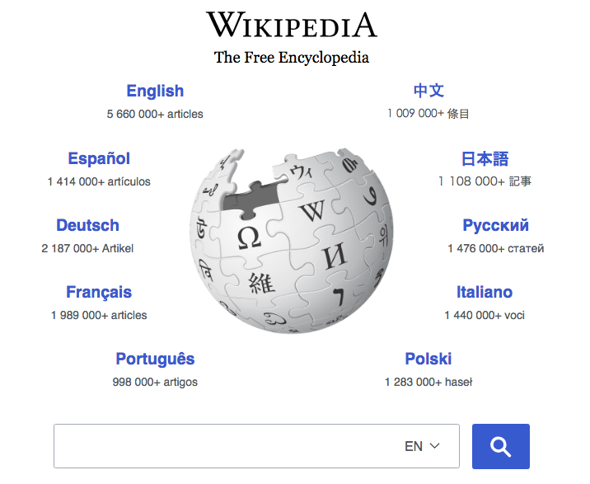
Wikipedia
Notes:
Allow people all over the world to collectively create and edit encyclopedia artiles

Slide 23
WikiProjects
WikiProjects are self-­organized groups of contributors within English Wikipedia community.
Notes:
working together to improve coverage of specific topics
Wikiprojects military history
Wikiproject film
Wikiproject women scientists

Slide 24
WikiProjects
WikiProjects are important socialization hubs
Editors seek help and find collaborators (Forte et al. 2012)
New members learn from experienced members. (Zhu et al. 2012)
Guide and organize editors’ work (Zhu et al. 2012)
Offer protection against un-warranted reverts and edit wars (Forte et al. 2012)
Notes:
While the number of WikiProjects reached a peak of about 2,157, as of July, 2017, there were only 506 active WikiProjects, and only 12% of them had more than 10 active members

Slide 25
WikiProjects
WikiProjects have been declining in the recent years
Peak: 2000 projects
Now: 500 active WikiProjects, 12% have more than 10 active members
Notes:
as of July, 2017, there were only 500 active WikiProjects, and only 12% of them had more than 10 active members
WikiProjects could benefit from infusions of new editors.
this would benefit Wikipedia as a whole,

Slide 26
The goal of the research
Design an intelligent recruitment algorithmic system to help WikiProjects identify and recruit suitable new members.

Slide 27
Challenges
Tools failed because they are insensitive to contributors’ motivations and community norms.
Notes:
Computer scientists have long worked to create software tools, including algorithms and user interface techniques, to solve problems in Wikipedia
Tools failed because they are insensitive to motivations of individual contributors and practices and norms of the community.

Slide 28
Challenges
Tools failed because they are insensitive to contributors’ motivations and community norms.
VisualEditor and MediaViewer pulled due to strong community pushback
Newcomers left the community (Halfaker et al. 2011)
Notes:
WMF had to pull the VisualEditor, MediaViewer due to strong community pushback
Newcomers leave in droves when rudely treated by algorithmic tools (Halfaker et al. 2011)

Slide 29
Challenges
Tools failed because they are insensitive to contributors’ motivations and community norms.
VisualEditor and MediaViewer pulled due to strong community pushback
Newcomers left the community (Halfaker et al. 2011)
Tensions between Wikipedia community and research community.
Notes:
research that performs offline analysis of articles and editor actions is typically non-controversial, but studies that involve interventions often encounter resistance from editors
MIT study that leads to blocking of the research accounts, heated discussion in Wikipedia community, and the creation of the new Wikipedia policy “Wikipedia is not a lab”)

Slide 30
Outline
Part 1. Overview of the VSAD approach
Part 2. Designing value-sensitive recruitment algorithms for projects in Wikipedia
Background and challenges
5-step process of creation and evaluation
Part 3. Lessons, Challenges and Discussions
Notes:
Problem/challenge

Slide 31
VSAD: 5-Step Approach
Step 1: Understand Stakeholders
Step 2. Algorithm Prototyping
Step 4: Iterative Refinement
Step 5: Acceptance, Accuracy and Impact (AAI) Evaluation
Step 3. Deploy Algorithm with Stakeholders
Notes:
Problem/challenge

Slide 32
VSAD: 5-Step Approach
Step 1: Understand Stakeholders
Step 2. Algorithm Prototyping
Step 4: Iterative Refinement
Step 5: Acceptance, Accuracy and Impact (AAI) Evaluation
Step 3. Deploy Algorithm with Stakeholders
Notes:
Problem/challenge

Slide 33
Step 1. Understand Stakeholders
Value: “what a person or group of people consider important in life” (Borning and Muller 2012).
Notes:
Review our definition
We use motivation, perspectives, needs, interests interchangeably.

Slide 34
Step 1. Understand Stakeholders
Newcomers to WP
Current WP members
Wikipedia as a whole
Three Stakeholders
Notes:
-15

Slide 35
Step 1. Understand Stakeholders
Review literature
Conduct surveys to WikiProject (WP) organizers/current active project members (50 members from 19 Projects).

Slide 36
Step 1. Understand Stakeholders
Summary of Stakeholders’ Values
 | Design Choices | Newcomers to WP | Current WP members | Wikipedia as a whole
“Who to recruit”
“How to define fit”
Human-algorithm coordination

Slide 37
Step 1. Understand Stakeholders
Summary of Stakeholders’ Values
 | Design Choices | Newcomers to WP | Current WP members | Wikipedia as a whole
“Who to recruit” | Experienced
 | Brand-new
“How to define fit”
Human-algorithm coordination
Notes:
hat the newcomers to WikiProjects might still vary a lot in terms of their experience in WikiPedia.

Slide 38
Step 1. Understand Stakeholders
Summary of Stakeholders’ Values
 | Design Choices | Newcomers to WP | Current WP members | Wikipedia as a whole
“Who to recruit” | Experienced | (+) | (+) | (+)
 | Brand-new | (+) | (0) | (+)
“How to define fit”
Human-algorithm coordination
Notes:
For the interest of the time,

Slide 39
Step 1. Understand Stakeholders
Summary of Stakeholders’ Values
 | Design Choices | Newcomers to WP | Current WP members | Wikipedia as a whole
“Who to recruit” | Experienced | (+) | (+) | (+)
 | Brand-new | (+) | (0) | (+)
“How to define fit”
Human-algorithm coordination
Tension: Current WP members prefer experienced editors.
For Wikipedia, it is critical to retain brand-new editors.
Notes:
In Wikipedia, the low retention of new editors has resulted in an overall decline in the active-editor base [15].
Although it is important to retain active and experienced editors
It is also critical to retaining new editors who do not have experience

Slide 40
Step 1. Understand Stakeholders
Summary of Stakeholders’ Values
 | Design Choices | Newcomers to WP | Current WP members | Wikipedia as a whole
“Who to recruit” | Experienced | (+) | (+) | (+)
 | Brand-new | (+) | (0) | (+)
“How to define fit” | Interest-based
 | Relationship-based
Human-algorithm coordination
Notes:
Synthesizzed : (1) they identify with the
group’s purpose (interest-based),
or (2) they have personal connections with current members of the

Slide 41
Step 1. Understand Stakeholders
Summary of Stakeholders’ Values
 | Design Choices | Newcomers to WP | Current WP members | Wikipedia as a whole
“Who to recruit” | Experienced | (+) | (+) | (+)
 | Brand-new | (+) | (0) | (+)
“How to define fit” | Interest-based | (+) | (+) | (0)
 | Relationship-based | (+) | (0) | (0)
Human-algorithm coordination
Notes:
Synthesizzed : (1) they identify with the
group’s purpose (interest-based),
or (2) they have personal connections with current members of the

Slide 42
Step 1. Understand Stakeholders
Summary of Stakeholders’ Values
 | Design Choices | Newcomers to WP | Current WP members | Wikipedia as a whole
“Who to recruit” | Experienced | (+) | (+) | (+)
 | Brand-new | (+) | (0) | (+)
“How to define fit” | Interest-based | (+) | (+) | (0)
 | Relationship-based | (+) | (0) | (0)
Human-algorithm coordination | Automation
 | “Human in the loop”
Notes:
Current members admit that is really labor intensive to manually go through the editors’ list and tried to identified and invited new members with potential.
They welcomed the prospect of an intelligent system to help them in to recruit new people.
Two possibilities

Slide 43
Step 1. Understand Stakeholders
Summary of Stakeholders’ Values
 | Design Choices | Newcomers to WP | Current WP members | Wikipedia as a whole
“Who to recruit” | Experienced | (+) | (+) | (+)
 | Brand-new | (+) | (0) | (+)
“How to define fit” | Interest-based | (+) | (+) | (0)
 | Relationship-based | (+) | (0) | (0)
Human-algorithm coordination | Automation | (0) | (-) | (0)
 | “Human in the loop” | (0) | (+) | (0)
Notes:
One possibility is to fully automate the process.
Or

Slide 44
Step 1. Understand Stakeholders
Summary of Stakeholders’ Values
 | Design Choices | Newcomers to WP | Current WP members | Wikipedia as a whole
“Who to recruit” | Experienced | (+) | (+) | (+)
 | Brand-new | (+) | (0) | (+)
“How to define fit” | Interest-based | (+) | (+) | (0)
 | Relationship-based | (+) | (0) | (0)
Human-algorithm coordination | Automation | (0) | (-) | (0)
 | “Human in the loop” | (0) | (+) | (0)
Pitfall: One respondent wrote: “The point is to help editors be better community members, not to coldly spam invites by algorithm.”
Notes:
According to the findings, members are strongly object to the idea of fully automating the process
these current members wanted to “be in the loop” and to maintain the key role in inviting newcomers.

Slide 45
Step 1. Understand Stakeholders
Summary of Stakeholders’ Values
 | Design Choices | Newcomers to WP | Current WP members | Wikipedia as a whole
“Who to recruit” | Experienced | (+) | (+) | (+)
 | Brand-new | (+) | (0) | (+)
“How to define fit” | Interest-based | (+) | (+) | (0)
 | Relationship-based | (+) | (0) | (0)
Human-algorithm coordination | Automation | (0) | (-) | (0)
 | “Human in the loop” | (0) | (+) | (0)

Slide 46
VSAD: 5-Step Approach
Step 1: Understand Stakeholders
Step 2. Algorithm Prototyping
Step 4: Iterative Refinement
Step 5: Acceptance, Accuracy and Impact (AAI) Evaluation
Step 3. Deploy Algorithm with Stakeholders
Notes:
Problem/challenge

Slide 47
Step 2. Algorithm Prototyping
Adapt the value analytic method (Miller et al. 2007)
Deal with ”Tension”: Develop parallel prototypes
Deal with ”Pitfall”: Remove design options that some stakeholders strongly object to.
Notes:
design options that some stakeholders find appealing and others do not strongly object to will be foregrounded in the design.

Slide 48
Step 2. Algorithm Prototyping
Candidate inclusion:
Include both brand-new editors and experienced editors.
Rank and present the two types of editors separately.
Notes:
so that the experienced editors do not overshadow the inexperienced ones.

Slide 49
Step 2. Algorithm Prototyping
Four Ranking Algorithms
Interest-based algorithms:
Rule-based algorithm
Category-based algorithm
Relationship-based algorithms:
Bond-based algorithm
Co-edit-based algorithm (a version of collaborative filtering)
Notes:
(1) ranks the match of an editor to a WikiProject by counting the number of (recent) edits by that editor to articles within the scope of the project.
(2) computing a similarity score between an editor’s edit history and the topic of a WikiProject
(3) ranks editors by the strength of “social connections” the editor has to current members of a WikiProject
(4) similarity of their edit histories to the edit histories of current members of a WikiProject
There is no learning-based algorithm

Slide 50
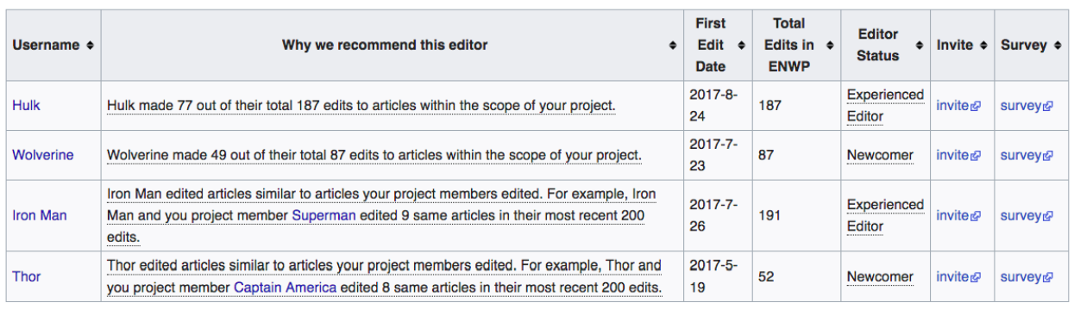
Step 2. Algorithm Prototyping
Algorithm results delivered to current WP members
User name
Explanation
Basic Information
Invite link
Survey link
Notes:
Instead of directly inviting the potential members, we designed a user interface for presenting recommended new editors to current WikiProject members
. The user interface was implemented as an interactive element within a Wikipedia page.
Table that showed basic information about each candidate editor, such as their user name and registration date. We also provided explanations for each recommendation
sked the current members to rate the suitability of the recommended editors and give overall feedback.

Slide 51
VSAD: 5-Step Approach
Step 1: Understand Stakeholders
Step 2. Algorithm Prototyping
Step 4: Iterative Refinement
Step 5: Acceptance, Accuracy and Impact (AAI) Evaluation
Step 3. Pilot Deploy Algorithm with Stakeholders
Notes:
Problem/challenge

Slide 52
Step 3. Working with the community
We communicated our research plan early with the community
Recruit participants using methods consistent with the community’s norms and practices. 26 WP members from 39 WPs signed up to test the algorithmic tool.
Work with communities to deploy the systems. Evaluated over 16,000 editors, delivered 4 distinct batches of 385 recommendations to 18 Wikiprojects over a 6-month period.
Notes:
Wikiproject X, Viligae pump and

Slide 53
VSAD: 5-Step Approach
Step 1: Understand Stakeholders
Step 2. Algorithm Prototyping
Step 4: Iterative Refinement
Step 5: Acceptance, Accuracy and Impact (AAI) Evaluation
Step 3. Deploy Algorithm with Stakeholders
Notes:
Problem/challenge

Slide 54
Step 4. Iterative Refinement
Collect both quantitative and qualitive Feedback
Survey link

Slide 55
Step 4. Iterative Refinement
Some sample refinement:
Refine algorithm explanations
Add filters to screen out candidate editors who have been blocked, banned, or received warning messages.
Boost thresholds in matching algorithms

Slide 56
VSAD: 5-Step Approach
Step 1: Understand Stakeholders
Step 2. Algorithm Prototyping
Step 4: Iterative Refinement
Step 5: Acceptance, Accuracy and Impact (AAI) Evaluation
Step 3. Deploy Algorithm with Stakeholders
Notes:
Problem/challenge

Slide 57
Step 5. AAI Evaluation
Community Acceptance (Qualitative)
Algorithm Accuracy (Quantitative)
Impacts on the community (Quantitative and Qualitative)
Notes:
25

Slide 58
Step 5. Acceptance Evaluation
Interview Quotes from current WP members who tested the tool.
“This puts some science behind recommendations, and will be a great supplement to the current processes. We’ve already had new members join thanks to [Researcher]’s tool.”
Notes:
We interviewed both current WP members and newcomers who were invited to the projects,
Although people provide lots of feedback on specific places they want to improve, all of them told us that the general experience is positive.
Although the results might be subject to self-selection bias, but still, our collaborator Aaron thinks this is pretty rare in Wikipedia community.

Slide 59
Step 5. Acceptance Evaluation
Interview Quotes from current WP members who tested the tool.
“My experience has been positive. The majority of the recommendations have been clueful and we’ve had a few positive responses. ”
Notes:
Although people provide lots of feedback on specific places they want to improve, all of them told us that the general experience is positive.
Our collaborator Aaron thinks this is pretty rare in Wikipedia community.

Slide 60
Step 5. Acceptance Evaluation
Message from new members who were invited to join the WP.
“Hi [Anonymized], This is [Anonymized]. Thank you for reaching out to me and thank you for informing me about the WikiProject Africa talk page… I appreciate it.

Slide 61
Step 5. Acceptance Evaluation
Feedback from the general Wikipedia community:
Created a Signpost to describe our project

Slide 62
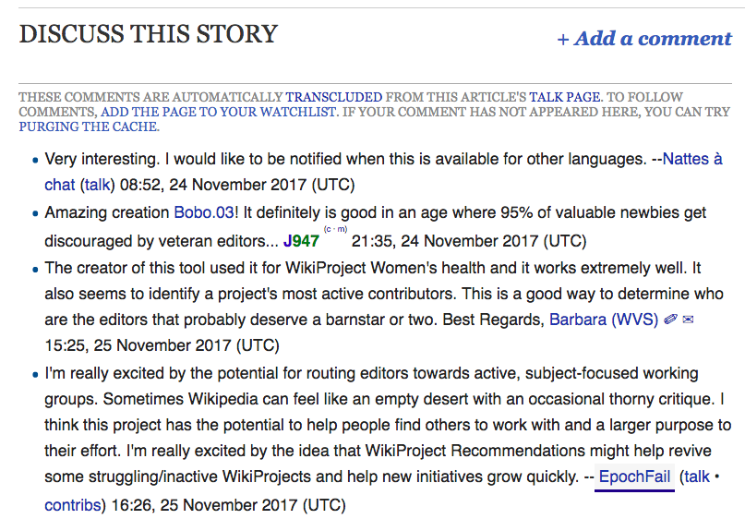
Step 5. AAI Evaluation: Community Acceptance
Very interesting.
Amazing creation.
I am really excited by the potential for routing editors towards active, subject focused working groups.

Slide 63
Step 5. Acceptance Evaluation
Positive influence on the relationship between Wikipedia community and research community

Slide 64
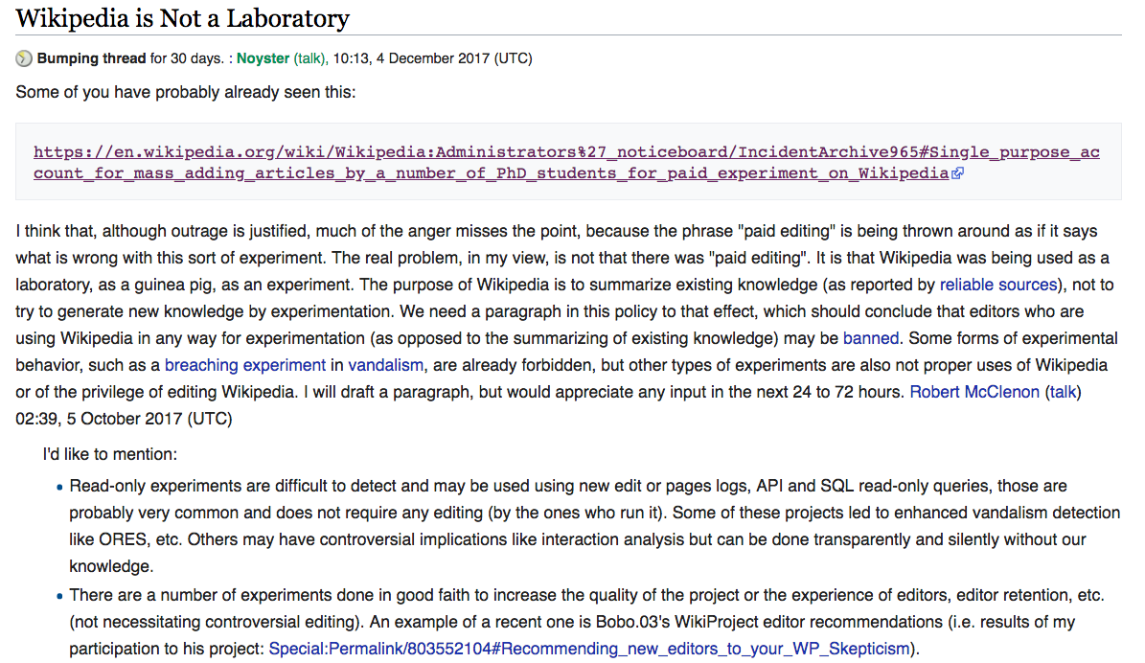
Step 5. Acceptance Evaluation
One editor argued for banning all experimental research on Wikipedia
“There are a number of experiments done in good faith to increase the quality of the project or the experience of editors, editor retention, etc. (not necessitating controversial editing). An example of a recent one is [researcher]'s WikiProject editor recommendations”
Notes:
: “The purpose of Wikipedia is to summarize existing knowledge .. not to try to generate new knowledge by experimentation.”

Slide 65
Step 5. AAI Evaluation
Community Acceptance
Algorithm Accuracy
Impacts on the community

Slide 66
Step 5. Accuracy Evaluation
Algorithm Types
 | Rule-based | Category-based | Bonds-based | Co-edit-based
Avg. Ratings | 3.24 | 2.36 | 2.33 | 2.76
Invitation Rates | 47% | 16% | 22% | 28%
Notes:
Rating. WikiProject organizers’ ratings on how good the recommendations are.
Invitation. Whether WikiProject organizers actually invite the recommended editors; this is analogous to clickthrough rate.
The rule-based algorithm was rated higher and resulted in more invitations compared to the other three types of algorithms:
One limitation is that we did not set up a baseline condition (random condition).
The random condition might cause negative experience for the members.

Slide 67
Step 5. Accuracy Evaluation
Newcomer Types
 | Experienced | Brand-new
Avg. Ratings | 2.85 | 2.88
Invitation Rates | 34% | 32%
Notes:
The average ratings (2.85 v.s. 2.88) and the invitation rates (34% v.s. 32%) are not that different between experienced and inexperienced newcomers.
reasonable invitation rate

Slide 68
Step 5. AAI Evaluation
Community Acceptance
Algorithm Accuracy
Impacts on the community

Slide 69
Step 5. Impacts on the Community
Questions:
What happened to the invited newcomers?
Are there second-order effects (e.g., effects on contribution outside the WP)?
Notes:
Do they behave differently from the uninvited newcomers?

Slide 70
Step 5. Impacts on the Community
Unsocialized Newcomers
Algorithm
Qualified Newcomers
Random
Recommended to current members
Random
Not Qualified
~16,000
Qualified, Not Recommended
N = 178
Recommended, Invited
N = 100
Recommended, Not Invited
N = 285
Notes:
By comparing not qualified and qualifited not recommended groups, we can test whether our algorithms actually distinguish “qualified” and “unqualified” newcomers.
What happened to the newcomers if they received invitations compared to those who did not receive the invitation messages.

Slide 71
Step 5. Impacts on the Community
Outcome variables:
Newcomers’ within-project edits after being evaluated/invited
Newcomers’ outside-project edits after being evaluated/invited
Notes:
(Q1: What happened to the newcomers if WP current members invite them to the projects?)
(Q2: Are there second-order effects?)

Slide 72
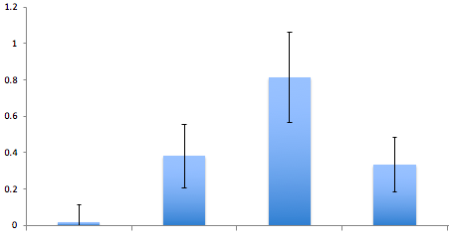
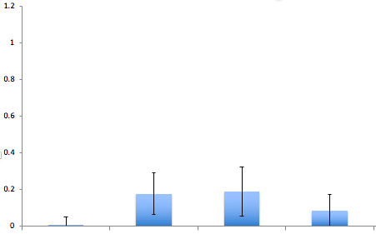

Step 5. Impacts on the Community
Within-project edits
Experienced Editors Brand-New Editors

Slide 73
Step 5. Impacts on the Community
Within-project edits
Experienced Editors Brand-New Editors
This is 7 days’ results. 30 days is similar

Slide 74
Step 5. Impacts on the Community
Within-project edits
Experienced Editors Brand-New Editors
p<0.01**
p<0.01**
Algorithms can identify newcomers who are more suitable and have potential to become serious contributors.
Notes:
qualified editors are much more likely to continuously contribute to the wikiprojects compared to the unqualified editors, regardless .

Slide 75
Step 5. Impacts on the Community
Within-project edits
Experienced Editors Brand-New Editors
p<0.01**
p<0.01**
Interpretation 1 (Selection): Current members did additional investigation and select the most promising newcomers
Interpretation 2 (Mentoring): Current members provided help and mentorship to newcomers which lead to more contribution
Notes:
Among all the experienced editors who are qualified based on the algorithm evaluation, the invited group performed significantly more than the other two groups. In fact, they almost doubled the contributions.

Slide 76
Step 5. Impacts on the Community
Qualitative evidence that supports the selection effect
“I look at the previous contributions and making sure they are a) productive (not mass deletions for examples which I have seen particularly for articles related to women), b) significant (not just fixing a typo), and c) not done by an editor with malicious intent or who has a thing for disrupting contributions to articles related to women athletes.”

Slide 77
Step 5. Impacts on the Community
Qualitative evidence that supports the mentoring effect
“I’ve received outreach from other member in the project, and I’ve been helped out. I want to write good pages….When you join a project like Chicago it’s so much work to be done. But I’ve received help from [Anonymized name] the organizer so I don’t feel like I am doing it alone. I feel that’s really helpful. ” – A newcomer who was invited
Notes:
Informational help
But also emotional

Slide 78
Step 5. Impacts on the Community
Some drawbacks of “Human in the loop”
“I do think having someone extend friendly invitations is nice and helpful, but at the same time, this is taxing on the inviting editor. I'm not particular interested in reviewing editors' contributions and extending invitations often..”

Slide 79
Step 5. Impacts on the Community
Within-project edits
Experienced Editors Brand-New Editors
p<0.01**
p<0.01**
n.s.
n.s.
However, invited brand-new editors did not contribute more than uninvited brand-new editors.

Slide 80
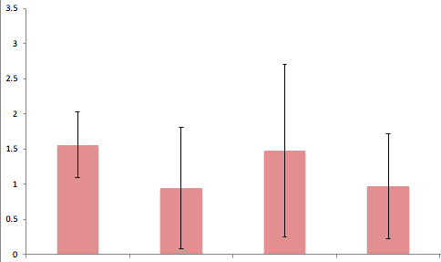
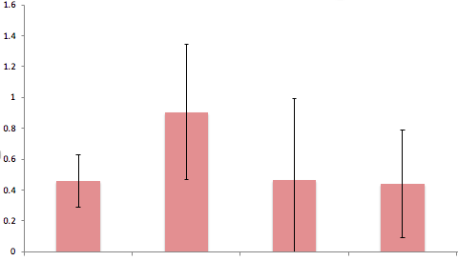
Step 5. Impacts on the Community
Outside-project edits
Experienced Editors Brand-New Editors
n.s.
n.s.
We did not observe effects on the outside-project edits.
Notes:
Increase in the within-project contributions did not come at the cost of fewer contributions out the project.

Slide 81
Step 5. AAI Evaluation
Community Acceptance
Algorithm Accuracy
Impacts on the community

Slide 82
Summary
Proof-of-concept case study: Design value-sensitive recruitment algorithms for Projects in Wikipedia
Well-accepted by the community
Brand-new editors were equally invited
Invited experienced editors had a significant increase in their within-project contributions
No effect on contributions outside the project
Notes:
Increase in the within-project contributions did not come at the cost of fewer contributions out the project.

Slide 83
Outline
Part 1. Overview of the VSAD approach
Part 2. Design value-sensitive recruitment algorithms for Projects in Wikipedia
Background and challenges
5-step process of creation and evaluation
Part 3. Lessons, Challenges and Discussions
Notes:
we identified a number of key challenges involved in conducting value- sensitive algorithm design

Slide 84
Discussions
How to address the gaps in technical literacy between non-expert stakeholders and algorithm developers
How can we effectively explain the algorithms to stakeholders and collect sensible feedback?
Notes:
-40

Slide 85
Discussions
How to address the mismatch between human-style reasoning and machine’s statistical approach
How can we effectively elicit stakeholders’ tacit values and insights?
How can we effectively and systematically translate human insights and feedback into algorithm creation?
How can we balance the different values?
Notes:
Problem/challenge

Slide 86
Discussions
Can the method scale?
How to aggregate hundred, thousands to millions of stakeholders’ feedback?
How to address the different levels of participation when engage massive stakeholders in the algorithm creation?
Notes:
Problem/challenge

Slide 87
Discussions
What are the trade-offs between the value-sensitive algorithm design approach, the Big Data-driven approach, and the pure human decision approach?
Notes:
Problem/challenge

Slide 88
Discussions
Can we apply the method to other more “high-stake” contexts?
Offender assessment
Children maltreatment
Immigrant assessment
Notes:
Would you really have access to the kinds of marginalized communities and stakeholders (like prisoners, mistreated children, etc) that could give you really insightful information about the impacts of these algorithms on their lives?

Slide 89
Some Possible Directions
Public
Al Designers
Technical Innovations
Novel Tools and Algorithm Approaches
‘Algorithmic thinking’ at all levels of education
Value-sensitive Algorithm Design
Educational Innovations
Notes:
allowing non-expert users to understand, monitor and influence algorithms. Technological innovation is an important way of effecting change, but educational innovation is also critical.
How can we educate an algorithmic literate society and promote “algorithmic thinking” at all levels

Slide 90

Thank You!
Loren Terveen
@UMN
Bowen Yu
@UMN
Aaron Halfaker
@WMF

